Slide 1
PHARMACY STORE MANAGEMENT
PRIYA JOSHI: 301
ANIKET SULKE: 307
PRASHANT PRINCE: 315
GUIDED BY: PROF. MAYURA KULKARNI

Slide 2

PROBLEM STATEMENT
To manage the pharmacy store by developing web application which is able to create different records involves in pharmaceutical store and also performs the data manipulation operations like insert, update, delete and search on the records.

Slide 3

OBJECTIVE
To develop a web application based system that increases the efficiency in medical stores.
To migrate from originally paper-based to electronic, notebooks with data storage, computational features and reliable electronic.
To develop a system that keeps all the record of entities involved in the Pharmacy store management.

Slide 4
FEATURES INCLUDED IN APPLICATION
Data manipulation operations can be performed only by authenticated users.
Unauthenticated users can only view the data.
Stores the necessary information about the medicines, drug manufacturer, patient, bill, employees, doctors etc.
Search the information of different instances from the database.
User can update the necessary information.
Login is provided for the security purpose.
User can delete the record.
User can download the record summary in the form of text or csv file.

Slide 5
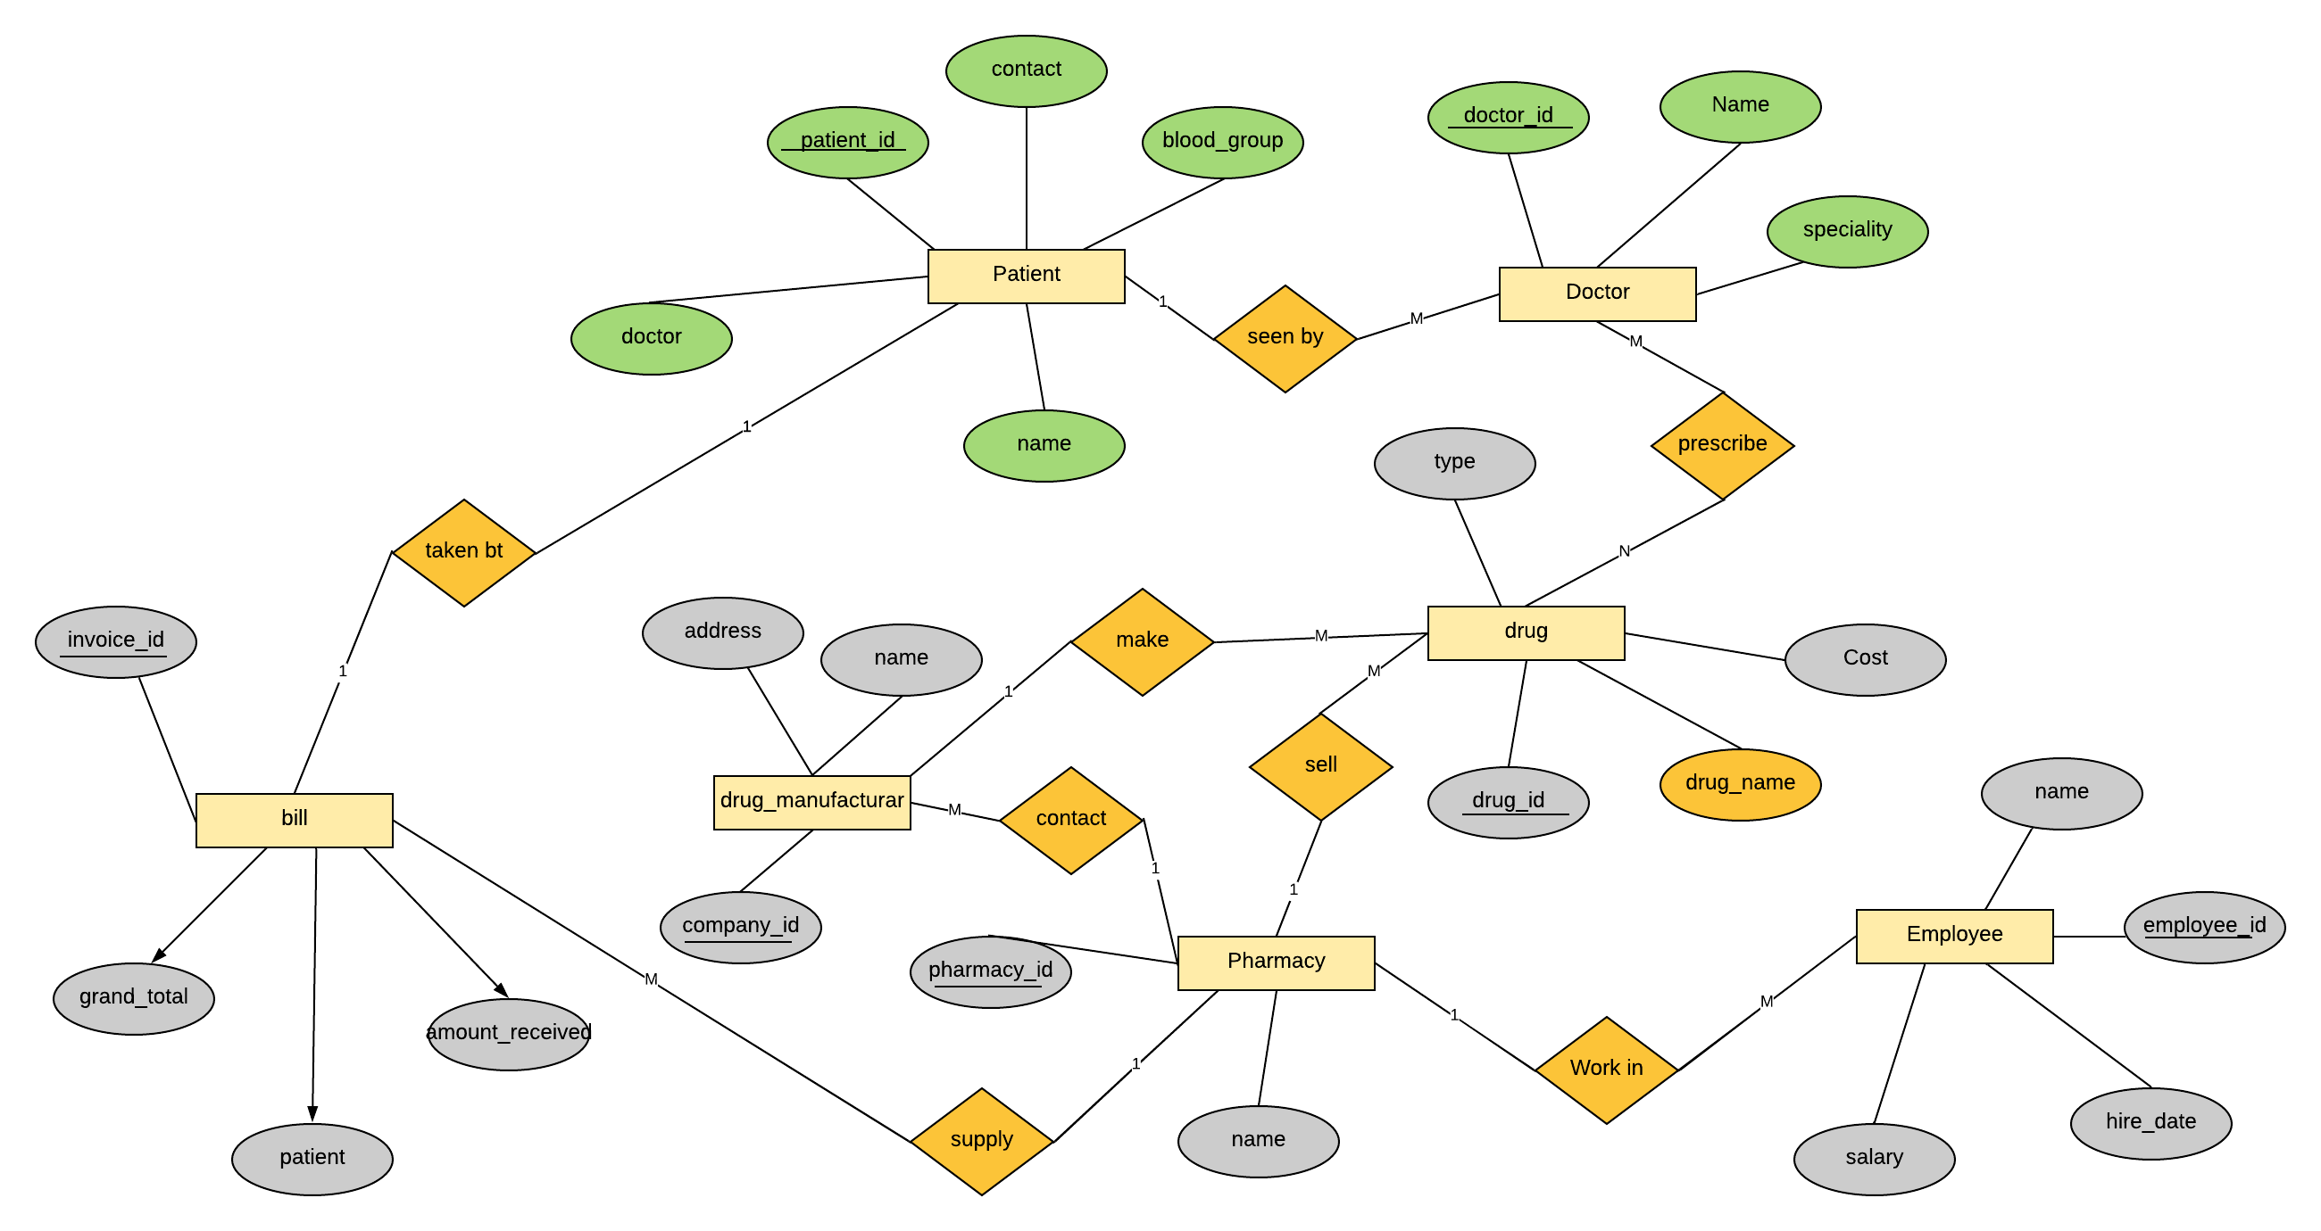
ER DIAGRAM

Slide 6
ENTITIES & ATTRIBUTES
DOCTOR
D_NAME
SPECIALITY
D_ID (PK)
PATIENT
P_NAME
P_ID
CONTACT_NO
Doctor
Blood group
Bill
Invoice id
Grand total
Patient
Amount received

Slide 7
Drug
Drug id
Name
Cost
Drug type
Employee
EMP_ID (PK)
AGE
SALARY
ID (FK)
DRUG_MANUFACTUR
COMP_ID (PK)
NAME
CITY
EMP_ID (FK)

Slide 8

Software requirements
Python
Django Framework
HTML
CSS
Bootstrap
SQL
Sublime Text 3

Slide 9

Implementation Details
Gathering information
Constraints and relationships
ER Design
Files creation using django-admin
Table creation and migration
Creation of view
Views templates
Urls
Deployment

Slide 10
Conclusion
This system keeps various records in database for further use and for various manipulations.
The login facility will be provided for the security purpose.
It shows the record of doctors and which doctor assigned to which patient. We can also modify the information.
The registered user who has created a particular record can only perform aggregations on that record.

Slide 11
References
[01] Abraham Silberschatz, Henry F. Korth, “DATABASE SYSTEM CONCEPTS”, 6th edition. Practice-Hall, 1977. (ISBN-9781259006395)
[02] https://www.codecademy.com/articles/bootstrap
[03] https://docs.djangoproject.com/en/2.2/
[04] https://sqlite.org/docs.html

Slide 12


